Slide 1

Studio Safety
By Stacy Whitaker
Notes:
The RTVF Studio is typical of what you will find in local television stations and production houses everywhere. Since this is a model of a working environment, where we have large mobile set pieces and equipment, safety is our number 1 concern and the priority for our students!
This presentation will provide you with the rules and procedures needed to keep yourself and others around you safe. I will attempt to hit on all of the major safety concerns in a studio environment, but keep in mind this list is not exhaustive and is amended from time to time.
With that said, please keep in mind that we must all work together to provide the safest working and learning environment we can for each other.

Slide 2
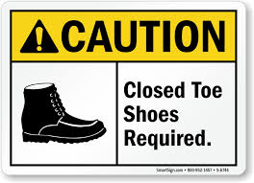
Clothing and Footwear
Do not wear anything with fringe or hanging material
Wear closed toe shoes
Notes:
Do not wear anything with fringe or hanging material that might get caught on set pieces or equipment as you are moving around the studio or trying to move something around in the studio. This could cause you to lose balance or drop something while trying to unravel yourself.
WEAR CLOSED TOE SHOES
Tennis shoes or a solid pair of boots are best. Anything with open toes is not permitted. This prevents injuries while equipment is being moved.

Slide 3
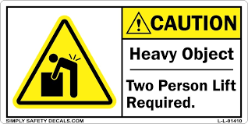
Moving and setting up items
NEVER MOVE ANYTHING BY YOURSELF
NEVER MOVE ANYTHING IF YOU HAVE PREVIOUS INJURIES
Notes:
NEVER MOVE ANYTHING BY YOURSELF.
Most of the equipment and set pieces in the studio are large and heavy. Avoid back strain or other bodily harm by working with a partner.
NEVER MOVE ANYTHING IF YOU HAVE PREVIOUS INJURIES.
If you have pre-existing back injuries, other physical injuries, or health issues that may be aggravated by moving an object, just let us know! Do not move anything that could cause you issues.

Slide 4

WATCH OUT FOR PINCHING HAZARDS!
LCD MONITORS
CRANE, PEDASTALS, C-STANDS
STAGE AND DESK PIECES
Notes:
LCD MONITORS
If you need to adjust height on the large LCD monitors, this is a two or even better, three person job, find an engineer or Tammy before attempting to do this.
CRANE, PEDASTALS, C-STANDS
The studio crane, tripods, and c-stands all have pivot points. Beware of pinching hazards on each of these items
STAGE AND DESK PIECES
Be extra careful dealing with the stage pieces. The legs are tight and can be difficult to fold in and out. There is a rubber mallet in the red cabinet to help. Also, be careful when connecting the stage pieces together.

Slide 5

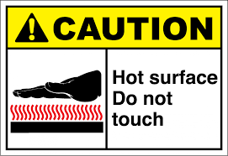
Lighting
MAKE SURE BREAKERS ARE OFF BEFORE CONNECTING LIGHTING
STUDIO LAMPS GET HOT!
LADDER and SCAFFOLDING USE
HALOGEN LAMPS
Notes:
BREAKERS OFF
Before you attempt to connect up a lighting jumper to the circuit panel, make sure the corresponding circuit is in the OFF position. If you fail to do this the connector could arch and shock you. Some of our larger lamps will trip the breaker when initially powered on. So you may have to flip the breaker off and back on once more to get it to power up. If the light doesn’t come on after a couple of tries, let an engineer or Tammy know so we can correct the issue.
STUDIO LAMPS GET HOT!
Make sure you use gloves when adjusting a lamp in the studio. Gloves are located in the red cabinet.
LADDER AND SCAFFOLDING USE
Typically, students are not allowed to climb the ladders. If a lamp needs adjustment and it is out of reach, find your instructor or an engineer for help. If you determine a studio lamp is blown, let Tammy or an engineer know so that we can replace it.
HALOGEN LAMPS
HALOGEN LAMPS ARE EXTREMELY SENSITIVE, USE GLOVES! If you touch a lamp with your bare hands, the oil off of your hand will make a weak spot in the lamp and when it gets hot it will explode sending molten glass on you, your equipment, and anything or anyone nearby. Believe me, I’ve seen it happen many times.

Slide 6


JUST A FEW OTHER THINGS…
NO FOOD OR DRINKS IN THE STUDIO
KEEP EXITS FREE OF OBSTRUCTION
FIRE EXTINGUISHER LOCATIONS
RELEASE BRAKES ON PEDASTALS, C-STANDS, ETC. BEFORE MAKING ADJUSTMENTS
HANDLE ALL STUDIO GEAR WITH CARE
DON’T FORCE ANYTHING!
Notes:
NO FOOD OR DRINKS IN THE STUDIO
Keep all food and drink in the designated areas. Food is typically not allowed in the studio during production, practice, or prep. Food causes distractions and may cause hazards if dropped or spilled.
KEEP EXITS FREE OF OBSTRUCTION
Keep all exits free of obstruction and keep belongings in a designated area out of the way of the main studio floor area. We don’t want anyone tripping over belongings and fire code dictates that we have a clear path to the exits.
RELEASE BRAKES ON PEDASTALS, C-STANDS, ETC. BEFORE MAKING ADJUSTMENTS
Make sure you release the brakes on the cameras, c-stands, and other pedestals/tripods before making adjustments. Not doing so will cause damage to the gear. If you see someone misusing the equipment please show them how to do it correctly or let your instructor or an engineer know so that we can assist them.
HANDLE ALL STUDIO GEAR WITH CARE
-Please handle items such as c-stands, apple boxes, and set pieces with care. We would like these items to last many years and be nice for future students.
-The 7 in 1 anchor desk has its own carts for both the desk pieces and the tops. Be gentle when taking the pieces on and off. Also make sure nothing is placed on these carts besides the intended desk pieces. We have had to make repairs and upgrades to the carts several times already.
DON’T FORCE ANYTHING.
If something does not twist or turn as it should, don’t force it. Find Tammy or an engineer for assistance.

Slide 7
SAFETY CONCERNS…
REPORT ANY SAFETY CONCERNS TO TAMMY OR ONE OF THE ENGINEERS. If you see something that doesn't look right or you feel could be a safety hazard, report it immediately.

Slide 8
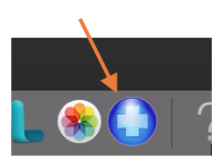
For a refresher…
Visit https://etsumcom.zendesk.com/hc/en-us
Click the Problem Report icon
Type Studio Safety in the search field

