Slide 1
Field Audio
By Stacy Whitaker

Slide 2
Safety
Gaffing Cables
Signs or barriers alerting public to tripping hazards
Handling Lamps (OK this has nothing to do with Audio)
Lights get hot! FAST! (Yeah, I know neither does this…but)
Over-under method for wrapping cable
Notes:
Gaffing Cables
Cable running across the ground or draped through the air are hazards. In a studio environment this is not as big of a deal because folks expect cables to be there, but out in public that is not the case. People don’t pay attention, so you have the responsibility to watch out for them.
Signs or barriers alerting public to tripping hazards
A lot of the time gaffing cables isn’t an option… grass, dirt, etc… In this case you may need to mark your scene off with barriers of some sort to alert passersby’s about any tripping or clipping hazards
Handling Lamps
Halogen lamps are extremely sensitive to any type of oil, especially our oily hands. Make sure that you do not touch a lamp with your bare hand or anything that has an oily substance on it. A clean paper towel or clean glove is best.
Lights get hot! FAST!
In film, photography, videography we use very bright lights. The lights draw anywhere from 150 to 2000 watts. The higher the wattage the hotter the lamp will be. Make sure you use gloves when making adjustments or handling production style lighting equipment.
Over-under method for wrapping cable
Properly wrapping cables speed things up when moving from scene to scene or between locations. Once you do it a few times, a cable can wrapped properly just as quick as wrapping it up the wrong way. Over under will keep your cables flat rather than having knotts or bends which could cause tripping hazards. Plus it will keep Candy from making you wrap it again when you drop it off at the ER.

Slide 3
Mic & Boom Techniques
Boom Pole Best Practices
Boom Pole Handling Noise?
Wireless & Lavaliere Best Practices
Phase Problems?
Notes:
Boom Pole Best Practices
Keep mic out of the frame! Keep eyes on the camera screen to see where the mic is at. In a handheld shot this is difficult so you have to be especially careful. If the camera is on a tripod you can use a frame line and orient that with a visual marker in the room.
Get as close as you can; point mic at the top of the actor's mouth.
Use rehearsal time to find the best recording location on the set.
Be aware of shadows and avoid these at all cost.
Be invisible! Do what you need to do with little to no interference of others so that the entire shoot can move forward smoothly.
Know the dialogue so that you can reposition the mic and have it oriented towards the actor who is speaking.
Don't boom from underneath—always go above!
If you have to ADR, use the same mic to insure consistency.
It's useful to have a lav on each of your actors so you can combine all signals. If you plan to use a wireless, plan wardrobe accordingly so that the mic can be effectively hidden.
Boom Pole Handling Noise?
Wear lightweight gloves. These make a tremendous difference and allow you to re-grip the pole with little to no handling noise.
Make the cable routing and connections as flexible as possible so that equipment can move freely. If you have to force or stretch your equipment you will introduce noise.
Wireless & Lavaliere Best Practices
Use the sensitivity adjustment on the transmitter to set initial levels.
Plug the receiver unit into a channel of the mixer. Consider splitting boom mic to the left channel and lav(s) to the right for independent control.
If using a mixer or Tascam unit, adjust Gain knob to set levels (try for ~0 VU).
Phase Problems?
Phase cancellation will leave the audio sounding thin, bright, nasal and quiet. Otherwise...bad!
With two lavs you can have problems with phasing if both mics are sent to same channel. Split the lavs to left and and right channels to minimize problems.
Additional phase problems? There is a phase invert switch on each mixer channel that may help. It looks like a 0 with a slash through it. Turn this on and listen for an improvement (ideally a fuller, richer, deeper sound).
The boom mic may contribute to phase problems as well. Try re-positioning to find the best arrangement. Realize that there is no "magic solution" when battling phase issues. Every variable of your shoot plays a part. Think creatively and pragmatically to find suitable workarounds and solutions.

Slide 4
Location Scouting
LISTEN!! And LOOK!!
Are sounds good or bad?
Can a masking sound be added (possibly in post)?
You might be able to a more directional mic
Notes:
When you go to check out a spot for a shoot—LISTEN!! And LOOK!!
What makes sounds in the environment?
Are any of these unwanted or potentially problematic?
Can you incorporate these elements into the scene? If so, then the noise is OK.
If you can't show the noise sources (don't fit the scene, sound sources are hidden, etc.) then you have to get creative and find a way to deal with them:
mask with blankets, pillows, carpet, foam, etc.
Can you add a sound into the scene that covers the noise or makes it less present in the mix?
You might be able to a more directional mic
Select a cardioid or super cardioid mic rather than an omnidirectional mic. Move the mic closer to the speaker to maximize the audio you want and minimize what you don’t want.
If you can't find a way to manage the noise (it is prohibitively bad and you can't justify the additional sound in some way), you have to talk to the director. They have to know that the shot must be looped (ADR) or the noise-making thing must be added into the scene in some way!

Slide 5
ADR, what’s that?
Also known as looping “in the biz”
Automated or Automatic Dialog Replacement
“Poor Man’s ADR”
ADR On a Budget
Notes:
Looping originally involved recording an actor who spoke lines in
sync to "loops" of the images which were played over and over along
with matching lengths of recording tape.
Of course, this is all done digitally now, we don’t need to loop tape or record to tape, we simply play back a clip and have the actors try to sync their lines up with the best they can. ADR, though faster, is still
painstaking work.
An actor watches the image repeatedly while listening to the original production track on headphones as a guide. The actor then re-performs each line to match the wording and lip movements. Actors vary in their ability to achieve sync and to recapture the emotional tone of their performance.
ADR is usually considered a necessary evil but there are moments when looping can be used not just for technical reasons but to add new character or interpretation to a shot. Just by altering a few key words or phrases an actor can change the emotional bent on a scene.
“Poor Man’s ADR” One trick that indie film makers will use is to record three passes with each actor on all of their dialogue. Make these recordings as clean as can be so that you can use them later if needed. Do this just after recording your live scene so that the dialogue is fresh in the actors mind. Acoustically, the sound will match the space since you are still in that environment and general location. Plus, all cast members are there so you don't have to schedule ADR sessions after the fact (saving time and money). You can also play the clip you just recorded back so that the actors can try to sync their audio to the original recording.
Looping & ADR On a Budget
In case you need to ADR something in the studio, make notes as to which mic you used so that you can re-record with consistency. A different mic will introduce a different tone and the dialogue will sound mismatched. Use the same mic and replicate the distance of the original recording.

Slide 6
Choosing a Mic
https://www.youtube.com/watch?v=_MMHi8bQVv0

Slide 7
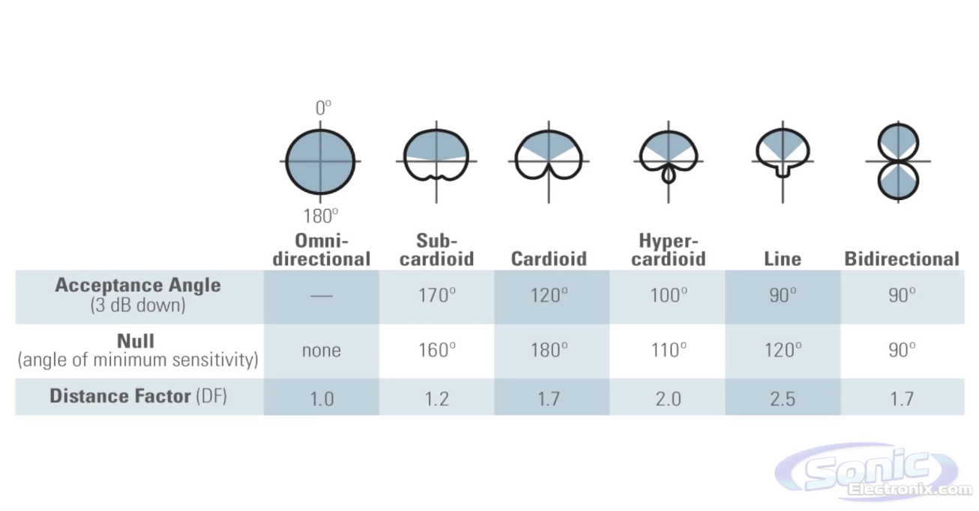
Pickup Patterns / Polar Patterns

Slide 8
REALISM
Live sound is very different than recorded sound
In real life we are able to cut out (from our hearing) any extraneous sounds and focus on single sounds…
Imagine a noisy party in which you are having a conversation with one person…
Notes:
Live sound is very different than recorded sound
In real life we are able to cut out (from our hearing) any extraneous sounds and focus on single sounds…
Imagine a noisy party in which you are having a conversation with one person…
When watching a movie or a TV show, this ability goes out the window. Ex. Hawaii 5-0
This is why good non distracting audio is key to a good film.

Slide 9
IMPORTANCE of Good audio
Sound is the first thing that separates amateur and professional film
Use a boom if you can
Wide shots demand wireless mics
A good boom operator will make all the difference
Notes:
Sound is the first thing that separates amateur and professional film. When the mic is 3' away from an actor and all you hear is room tone, the film sounds amateurish.
Use a boom if you can. This gets the best sound if within 12-18" of an actor.
Wide shots demand wireless mics. With wireless lavs, the sound will not always be as consistent due to head movement. This is OK if the scene is relatively still, but will be problematic if actors are moving a lot. The sound from a lav is not as full and rich, but it can work well when a boom is unfeasible.
Place the mic where you can imagine the point of a v-neck sweater. The middle of the actor's chest is the ideal place for it to go, but costume constraints may not allow this.
This isn’t always possible so remember that as with most situations, you have to balance "the ideal situation" with the limitations of your particular circumstances. You may have to get creative with mic placement and adjust your input levels to accomadate.
A good boom operator will make all the difference. They look at the framed shot in the camera to check their position. The mic should be as close to the frame line as possible and move with the actor or actors.
The boom operator should wear headphones and stay on top of the actor as they move through the scene.
If you have a separate person running audio, then they definitely need to have headphones to monitor as well. You can use a splitter so that both the boom operator and sound mixer can wear headphones.

Slide 10
Importance of Good Audio (continued)
When doing News or Documentary take headphones!
Hide the lav mic cord
Scratchy mics are bad
Never hold a lav mic…. That just looks stupid!
Check recording!
Notes:
When doing News or Documentary take headphones! If you can’t where the headphones while recording, use them before and after to make sure you have good levels.
Hide the lav mic cord. Leaving the mic cord dangling in the shot looks unprofessional and like you just don’t care. Tuck it away or run it up through your shirt or jacket to hide the cord.
Scratchy mics are bad! Make sure you place the mic in a fashion that it isn’t going to rub against clothes, chin, beard, etc. Also make sure there is some slack on the cord so that it doesn’t pull tight inducing noise.
Never hold a lav mic…. That just looks stupid! Don’t let your interviewee hold the lav mic. Also, if you are interviewing people, hold the mic for them. Letting the subject hold the mic again looks unprofessional!
Check recording! Before you leave the scene and before you let the interviewee leave, CHECK YOUR RECORDING! You don’t want to have to call someone back out for an interview because you recorded bad audio. Might want to double check the video while your at it.

Slide 11
Tricks of the trade
Consider bringing carpet samples to help contain “rogue sounds”
Know what your actor sounds like
Record ambience sample
Record sounds you think might be needed for your film
Notes:
Consider bringing carpet samples to help contain “rogue sounds”
Carpet samples are a good audio damper and can be placed over noisy items to help soften them a bit. Just be careful not to start a fire or overhead something.
Know what your actor sounds like
As an audio engineer on set, get the voice of the actor in your head. Know what this person sounds like so that when the acoustic situation on the set is bad you can make adjustments that allow them to sound "right" (like themselves). You don't want to add anything, you just want to be sure that regardless of the conditions their voices sound natural.
For instance, with wireless mics, the hi-end can get lost due to the mic being hidden under clothing. Add some high frequencies in the EQ to compensate for this. If this isn't possible in the field, you can do it in post as well.
Record ambience sample
Be sure to record the room (or your outside set location) with nothing happening for at least 30 seconds. This sample of ambience can be used to fill gaps or help "dirty up" takes in which the audio sounds unnatural or is disrupted by clothing noise, etc.
Similarly, when you're on the set, take advantage of the location and props and record the sounds you think might be needed for the movie.
A portable Zoom recorder is great for this because you can quickly steal away and get these sounds without disrupting your work flow.

Slide 12
So what equipment do you have access to?

