Slide 1
Interchangeable Lens Camera Basics
By Stacy whitaker

Slide 2
Types of cameras Available in the Department of Media and Communication
DSLR Cameras (Digital Single Lens Reflex Cameras) - T5i, T7i, Nikon D3000
Mirrorless Interchangeable Lens Cameras - Blackmagic Pocket Cinema
CMOS Sensor Cameras / fixed lens - Sony Z150, Panasonic AC130
3CCD Cameras - Sony SP-370, Panasonic HMC 150
Notes:
DSLR’s have replaced the older analog camera version known as SLR cameras. SLR’s typically recorded images to film rather than digitally to an SD card
Mirrorless Interchangeable Lens Cameras are basically the mirrorless counter part to a DSLR camera. These cameras do not have a mirror that send ligtht to the image sensor, rather they pass light directly to the sensor.
-These cameras typically offer better low light shooting quality.
-More geared for video rather than photography
-Typically light weight and faster to focus and color balance
Drawbacks: battery life due to sensor always being activated, fewer lenses and accessories available.
CMOS Sensor Cameras – basically the same as Mirrorless only we are referring to video cameras specifically. These cameras typically have larger image sensors. Quickly becoming the camera of the future, replacing in large # the traditional broadcast work horse 3CCD.
3CCD Cameras have for years, been the industry standard for quality and reliability. However, due to the advances in CMOS technology and the fact that it is much less expensive to manufacture, CMOS sensors are quickly replacing 3CCD. 3CCD cameras have 3 sensors, taking separate measurements of red, green, and blue light. A prism is used to filter out each color to its proper sensor. This 3 color light sampling has historically provided great precision in image quality, but again CMOS technology has now advanced to as good and possibly better quality. Their isn’t much room for improvement over current 3CCD quality (it is pretty much as good as its going to get), but CMOS improvements are sure to continue.

Slide 3
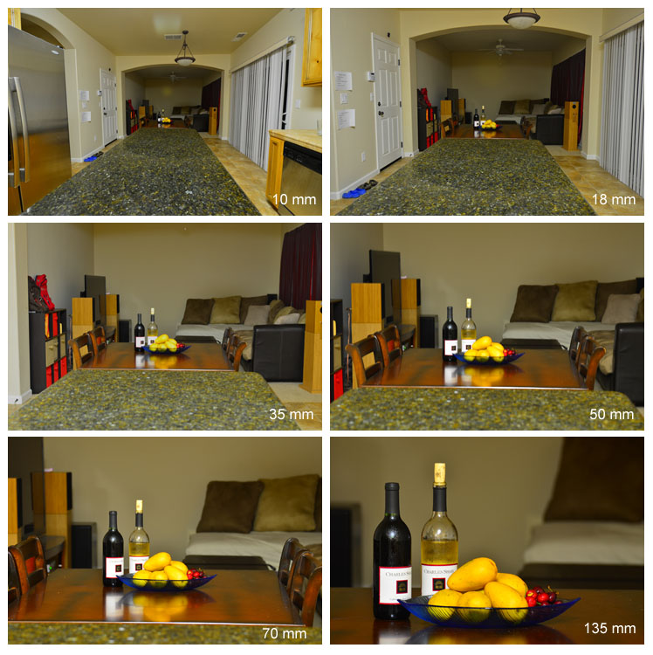
Focal Length
Measurement of field of view (usually in millimeters mm)
Most cell phone cameras are basically 14mm focal length
The higher the focal length the tighter the zoom
Lower focal length equals wider angle shot

Slide 4
Crop factor
All cameras with interchangeable lenses have a crop factor unless they have a full frame sensor
T5i and T7i both have APS-C sensor with a crop factor of 1.6x
Blackmagic Pocket Cinema camera has a micro four-thirds sensor with a 2.0x crop factor
All lenses are based on the 35mm standard, which is equivalent to a full frame sensor
This means that all lens focal lengths must be adjusted for crop factor

Slide 5
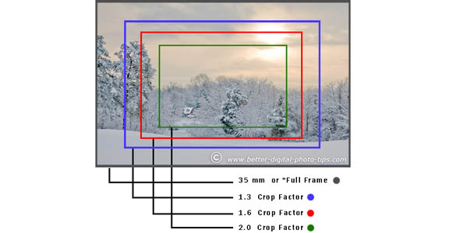
Crop factor

Slide 6
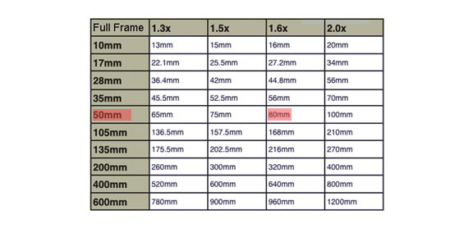
Crop factor

Slide 7
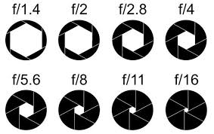
Aperture / Iris
Opening of the diaphragm inside the lens which controls how much light hits the sensor
Described in F-stops (typically f/1.2 up to f/16 or f/22)
Lower F-stop = wider aperture = more light
Also helps to control depth of field (focus in front and behind the subject)
Notes:
Aperture is the opening of the diaphragm. If the diaphragm is adjustable it is called an Iris.

Slide 8

Depth of Field
Prime lenses typically give you a wider max aperture allowing for a more shallow depth of field
When shooting video a shallow depth of field can cause issues if the subject is moving, they will drift in and out of focus
Typically a shallow depth of field is preferred for photography so that the subject is the main focus of the image and distractions around the subject are minimized.

Slide 9

Depth of field
Distance also affects depth of field
As you move closer to your subject, the area of the image that is in focus gets smaller
f/5.6 at 2ft away
f/5.6 at 10 feet away

Slide 10
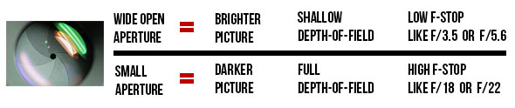
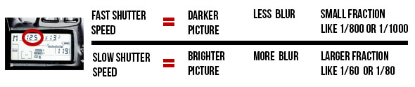
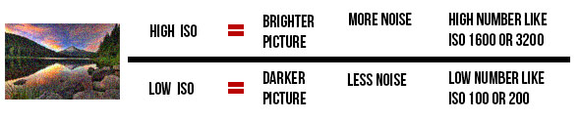
Exposure
The amount of light that hits the sensor
Aperture, Shutter Speed, and ISO all affect Exposure

Slide 11
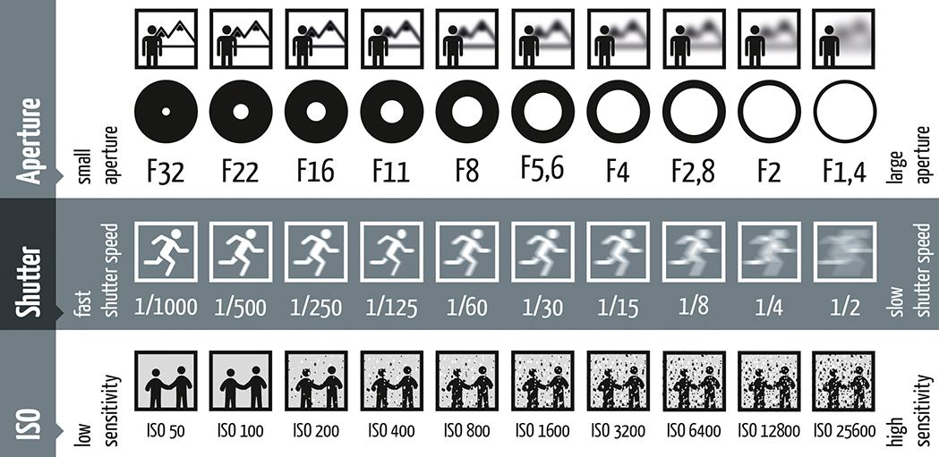
Aperture, Shutter, ISO (Exposure Triangle)
Notes:
Small aperture deep depth of field, wide aperture shallow depth of field
Fast shutter speed less blur, slow shutter speed more blur. Fast shutter speed also equals less exposure and darker image.
ISO determines the sensitivity of the image sensor. How clear or grainy your image will be when it hits the sensor. Higher ISO’s will brighten up a dark setting but induce more noise, where as a low ISO will result in a darker image but with less noise or grain in the photo or video.
All three of these settings must be adjusted for the best shot or the shot you are going for.
Having a basic understanding of what each of these settings do helps, but to really understand and get proficient, it takes practice and experience. The key is to get a camera and play around to find out what works for you!

Slide 12
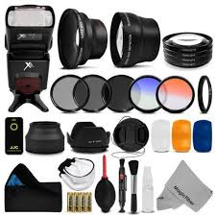
Accessories
Lens filters
Step-Up / Step-Down Rings
Mount adapters
Notes:
UV/Clear/Haze Filter Protects the front element of a lens from dust, dirt, moisture and potential scratches. High quality UV filters can be permanently mounted on lenses with a minimum impact on image quality.
Polarizing Filter Filters out polarized light, dramatically reducing reflections, enhancing colors and increasing contrast. Can be used for any type of photography. Polarizing filters are typically circular, allowing for easy control of the effect of polarization.
Neutral Density (ND) Filter Reduces the amount of light entering the lens, thus decreasing camera shutter speed. Useful for situations where motion blur needs to be created (rivers, waterfalls, moving people) or large apertures must be used with flash to avoid overexposure.
Step-Up / Step-Down Rings allow you to use larger and in some cases smaller filters on different lenses. Typically on the inside ring of the lens you will find the ring diameter. This will tell you what size filter diameter you need or what step up or down rings are going to be needed to adapt to your filter.
Mount Adapters are needed when using lenses with a different mount than what is on the camera. Not all mounts are adaptable. For example, you can adapt a Canon EF lens to a Micro 4/3 mount, but you can’t go the other way with a MFT lens for a EF mount. Micro 4/3 lenses are made to project an image directly to a mirrorless camera CMOS type sensor, where as Canon EF lenses are designed for the wider, reflective system. So the optical components for back focus are not set up to do this conversion.
There are other examples, but the key is to make sure when purchasing lenses and cameras you pick something that will be expandable for the future.

